Slide 1
Dependency Checking
Michael Alberhasky – ITS-AIS
June 29, 2023

Slide 2

What keeps developers up at night?
Vulnerable developer workstation/laptop
Insecure design
Exploitation of vulnerable libraries
Dependency Checking

Slide 3
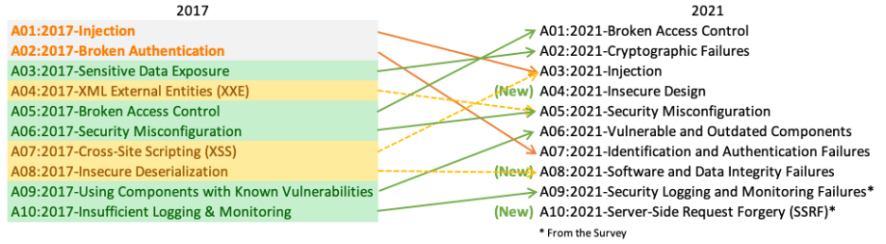
OWASP Top Ten
Dependency Checking
Notes:
We take an OWASP security compliance every year
Was at position 9 in 2017 and moved up to 6th place in 2021.

Slide 4
How do you manage your dependencies?
Dependency management in Java uses:
  Ivy for Play 1.x
  Manual for MAUI
  Gradle for just about everything else
Dependency Checking

Slide 5
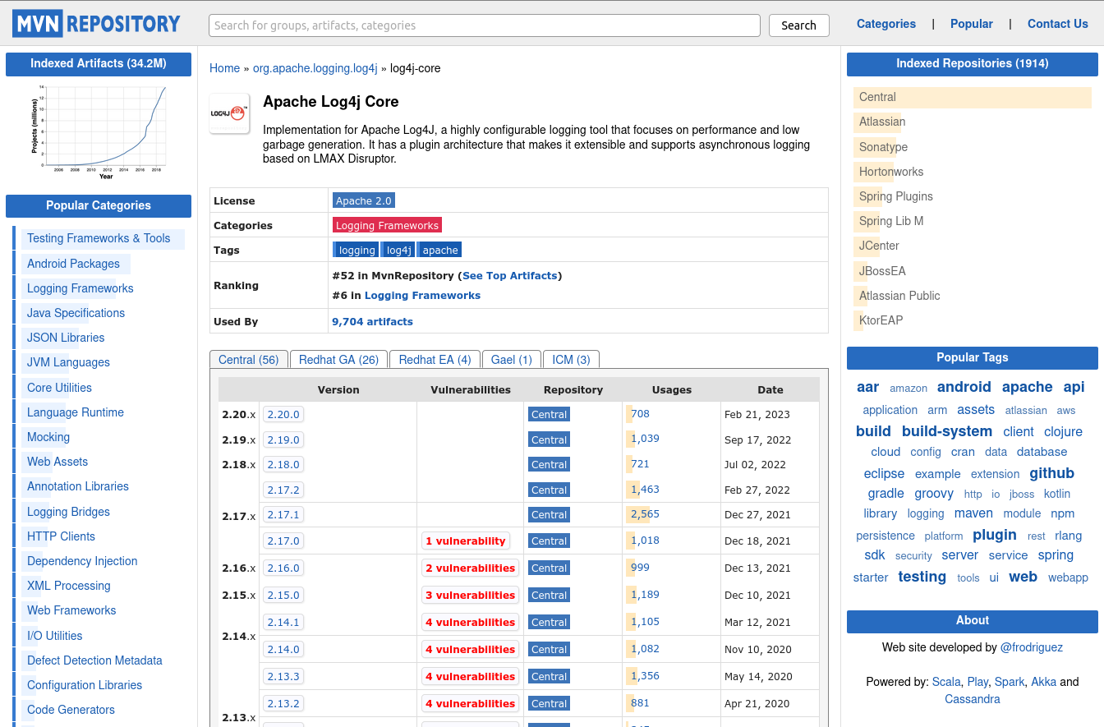
How do you know when something is vulnerable?
Forums
Issues
Email lists
ISPO
Headlines
Dependency Checking

Slide 6
Automated dependency checking
Gitlab dependency scanning
IntelliJ “Package Checker” plugin
Other commercial offerings
OWASP Dependency Check
Dependency Checking

Slide 7

OWASP Dependency Check
Free
Pulls data from:
  NVD database at NIST
  CISA Known Vulnerabilities
  Sonatype OSS Index
  RetireJS
Scans your libraries for known vulnerabilities
Analyzes Java, JS, Ruby, .Net, (Experimental: GoLang, Python, PHP Composer, Swift)
Can run from CLI, Gradle, Maven, Ant, Jenkins, SBT
Dependency Checking

Slide 8
How it works
Pulls data from vulnerability databases (NVD, CISA, etc.)
Stores that in a database (H2 by default or external like Oracle or MySql).
Compares libraries against entries in database.
Updates database periodically
Generates a report
Dependency Checking

Slide 9
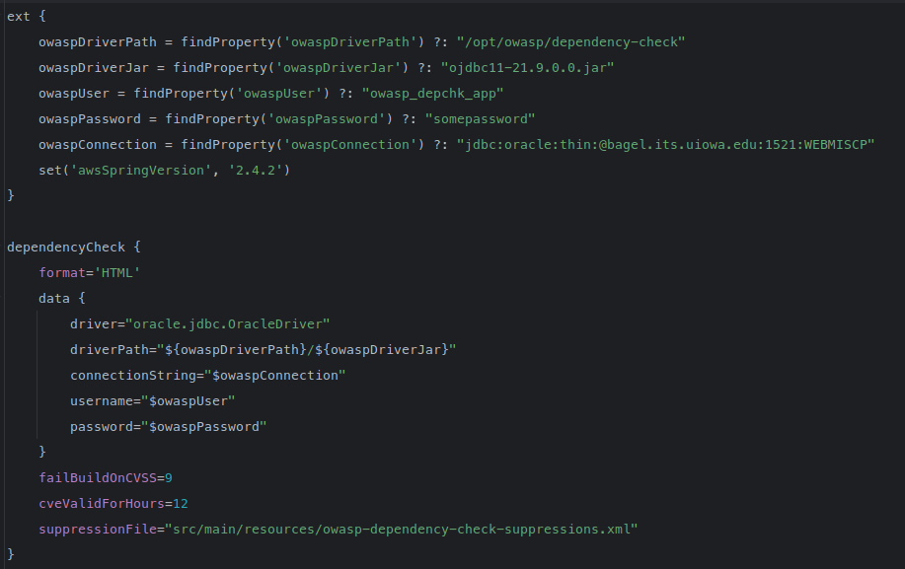
Config
Dependency Checking

Slide 10
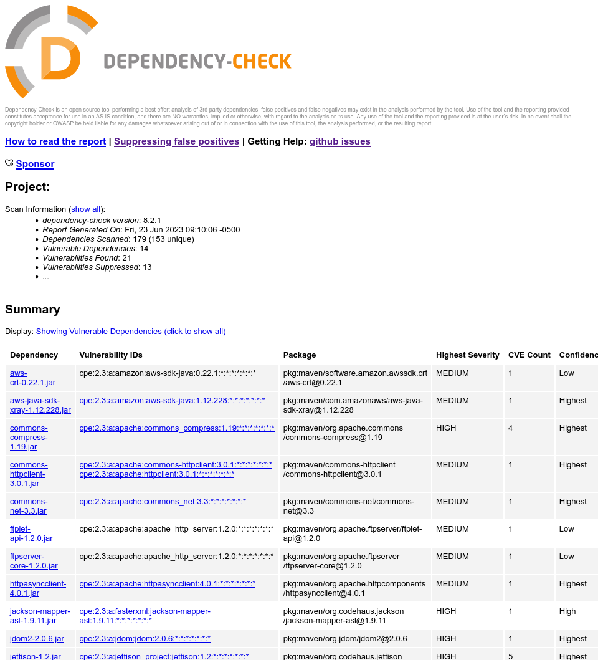
Reports
Dependency Checking

Slide 11
Remediation
No quick and easy was to work through an older app with lots of aging dependencies
Start with the worst offenders
Test, test, test
Dependency trees are your friend
Dependency Checking

Slide 12

Container scanning
You need to worry about dependencies inside your containers as well.
Gitlab has support for automatically scanning using Trivy.
Just like OWASP, configure to report on a threshold of badness.
Dependency Checking

Slide 13

Next steps
Continue to move apps from Bamboo to GitLab.
Get more apps to adopt ODC scanning.
Investigate using Renovate to help automate dependency upgrades.
Dependency Checking

Slide 14
Dependency Checking
Questions?
Michael Alberhasky
Lead Application Developer
ITS-AIS
michael-alberhasky@uiowa.edu
uiowa.edu

